Slide 1

CHAPTER 11 cloud Infrastructure, DevOps, and Monitoring in Azure
|LEARNING MICROSOFT AZURE

Slide 2
Introduction
Overview:
Understanding Azure’s offerings in cloud infrastructure and development.
Key focus on automation, scalability, and efficient monitoring practices.
Objectives:
Discover benefits of cloud-native architecture.
Explore DevOps practices for continuous delivery.
Learn how Azure facilitates effective monitoring and management.

Slide 3
Why Cloud-Native Infrastructure?
Definition: Architecture built to fully leverage cloud capabilities, focusing on flexibility, scalability, and resilience.
Key Characteristics:
Microservices-based
API-driven
Automation-centric

Slide 4
Core Components of Cloud Infrastructure
Compute Services: Virtual Machines, Azure App Service, Azure Kubernetes Service (AKS).
Storage Solutions: Azure Blob Storage, Azure Data Lake, Azure SQL Database.
Networking Services: Virtual Networks, Load Balancers, Azure Front Door.
Management Tools: Azure Resource Manager, Azure Monitor, Azure Automation.

Slide 5
Introduction to Microservices Architecture
Concept: Dividing applications into small, independent services.
Advantages:
Independent scaling and deployment.
Enhanced fault tolerance.
Technology-agnostic: Services can use different programming languages or databases.
Use Cases: Netflix, Amazon, and Uber.

Slide 6
Containerization in Azure
What is Containerization?
Packaging software with its dependencies into a 'container' for easy deployment.
Technologies: Docker, Kubernetes, and Azure Container Instances.

Slide 7
Understanding Orchestration
Definition: Coordinating and managing container deployment at scale.
Kubernetes Functions:
Load Balancing: Distributes network traffic evenly across services.
Auto-Scaling: Automatically adjusts the number of running containers.
Self-Healing: Replaces or restarts failed containers automatically.

Slide 8
Modern Application Development with DevOps
Definition of DevOps:
Cultural shift that unifies development (Dev) and operations (Ops) teams.
Key Principles:
Automation: Automate repetitive tasks, including testing and deployments.
Collaboration: Continuous feedback and integration between teams.
Continuous Improvement: Regular updates and enhancements.

Slide 9
Continuous Integration (CI)
Concept: Integrate code into a shared repository multiple times per day.
CI Pipeline Stages:
Code Compilation: Verifies code builds correctly.
Automated Testing: Unit, integration, and functional tests.
Artifact Storage: Compiled code stored for deployment.
Azure DevOps Tools for CI: Azure Pipelines, GitHub Actions.

Slide 10
Continuous Deployment (CD)
Definition: Automatically deploying code to production after passing CI tests.
CD Pipeline Steps:
Pre-Deployment Approvals: Optional manual checks.
Deployment to Staging: Testing in a production-like environment.
Production Release: Gradual or complete rollout.
Advantages:
Rapid delivery of features and fixes.
Improved product stability and security.

Slide 11
Introduction to Azure DevOps
What is Azure DevOps?
A cloud-based suite of tools for DevOps practices.
Supports the entire software development lifecycle (SDLC).
Key Components:
Collaboration tools to enable teams (developers, project managers, and stakeholders).
Focus on agile methodologies and continuous improvement.

Slide 12
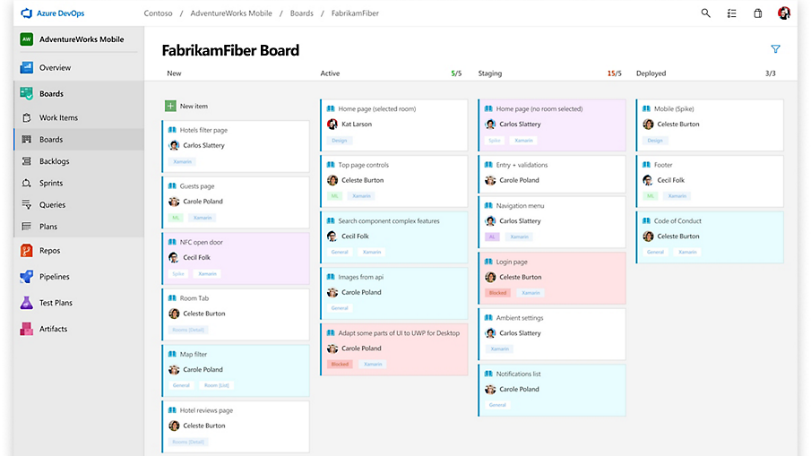
Azure DevOps Dashboard
Overview:
Central hub for managing DevOps projects.
Customizable dashboards to track progress and metrics.
Components of the Dashboard:
Azure Boards: Work items, backlogs, and sprint progress.
Azure Pipelines: Build and release statuses.
Azure Repos: Code repository activity.

Slide 13
Azure Boards
Purpose: Agile project management and planning.
Key Features:
Work Items: Create and manage user stories, tasks, and bugs.
Backlogs: Prioritize tasks for sprints.
Sprints: Plan and track progress of work in iterations.
Integration with Azure Repos:
Automatically link commits and pull requests to work items for traceability.
Ideal For: Teams practicing Scrum or Kanban methodologies.

Slide 14
Azure Pipelines
Purpose: Implement Continuous Integration/Continuous Deployment (CI/CD).
Key Features:
Build Automation: Compile code, run tests, and create artifacts.
Release Automation: Deploy applications to various environments.
Multi-platform Support: Works with any language and cloud.
Use Case Example: Automatically trigger builds on code commits, ensuring fast feedback loops.

Slide 15
Azure Repos
Purpose: Version control system for source code.
Key Features:
Git Repository: Supports both centralized and distributed version control.
Branch Policies: Set up code quality gates before merging code.
Pull Requests: Facilitate code reviews and discussions.
Benefits:
Collaboration on code changes with a structured review process.

Slide 16
Azure Test Plans
Purpose: Manage and execute tests for quality assurance.
Key Features:
Test Management: Create and manage test cases and suites.
Manual Testing: Execute tests and log results.
Automated Testing Integration: Link automated tests with CI/CD pipelines.
Benefit: Ensures quality by identifying defects early in the development process.

Slide 17
Built-in Analytics and Reporting
Analytics Features:
Dashboards: Visualize project health and team performance.
Reports: Generate reports on build success rates, release quality, and team velocity.
Benefits:
Data-driven decision-making helps identify bottlenecks and improve processes.
Track team performance against KPIs for accountability.

Slide 18
GitHub for DevOps
Overview:
GitHub: A leading platform for version control and collaboration.
Popular among open-source communities and education sectors.
Key Features:
Repositories: Store code with version control.
Actions: Implement CI/CD directly within GitHub.
Community: Extensive network for collaboration on open-source projects.
Use Case Example: Educational institutions using GitHub to teach version control and collaborative software development.

Slide 19
GitHub for Education
Applications in Education:
Teaching version control and collaboration through real-world projects.
Facilitating student participation in open-source initiatives.
Benefits:
Encourages hands-on learning and engagement.
Provides students with practical experience in software development.

Slide 20
Infrastructure Automation with IaC (Infrastructure as Code)
What is IaC?
Managing and provisioning computing resources using machine-readable configuration files.
Tools in Use:
Azure Resource Manager (ARM): Declarative templates for Azure resources.
Terraform: Open-source IaC tool supporting multiple cloud providers.
Bicep: Simplified syntax for ARM templates.

Slide 21
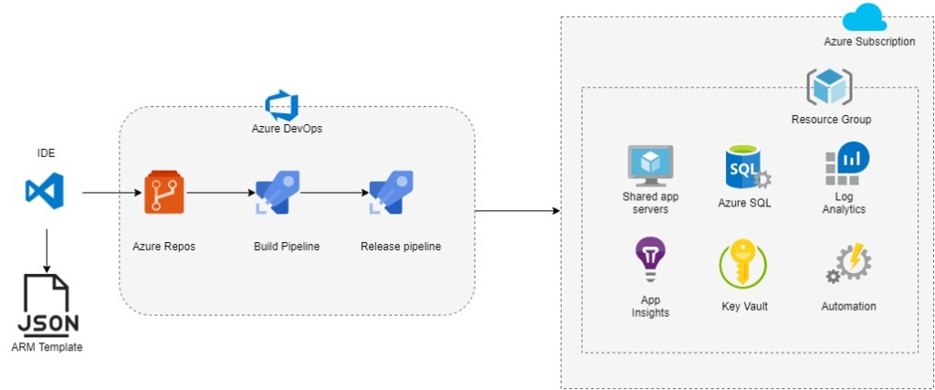
IaC Workflow
Process Flow:
Design: Define infrastructure requirements.
Code: Write infrastructure configuration.
Implement: Deploy infrastructure using scripts.
Update: Modify configurations as needed.
Outcome: Faster and more reliable infrastructure deployments.

Slide 22
Azure Resource Manager (ARM) Templates
Overview:
A management framework for deploying and managing Azure resources.
Deployment and Management: Uses declarative JSON templates.
Features: Resource grouping, role-based access control, and tags for organization.
Components of ARM Templates:
Parameters: Input values at deployment time for reusability.
Variables: Internal values used throughout the template.
Functions: Custom logic defined within the template.
Resources: Specification of resources to deploy.
Outputs: Returns values upon deployment completion.

Slide 23
Azure Bicep
 | ARM | Bicep
Syntax | JSON | Simplified syntax
Integration | Deep Azure integration | Focused on ease of use
Features | Rich features | Streamlined for simplicity
Compatibility | Widely used | Compatible with Kubernetes and ARM
A domain-specific language (DSL) for Azure resource deployment.
Advantages of Bicep
Simpler syntax, improved readability, and modularity.
Transpilation to ARM
Bicep templates are converted to ARM templates for deployment.

Slide 24
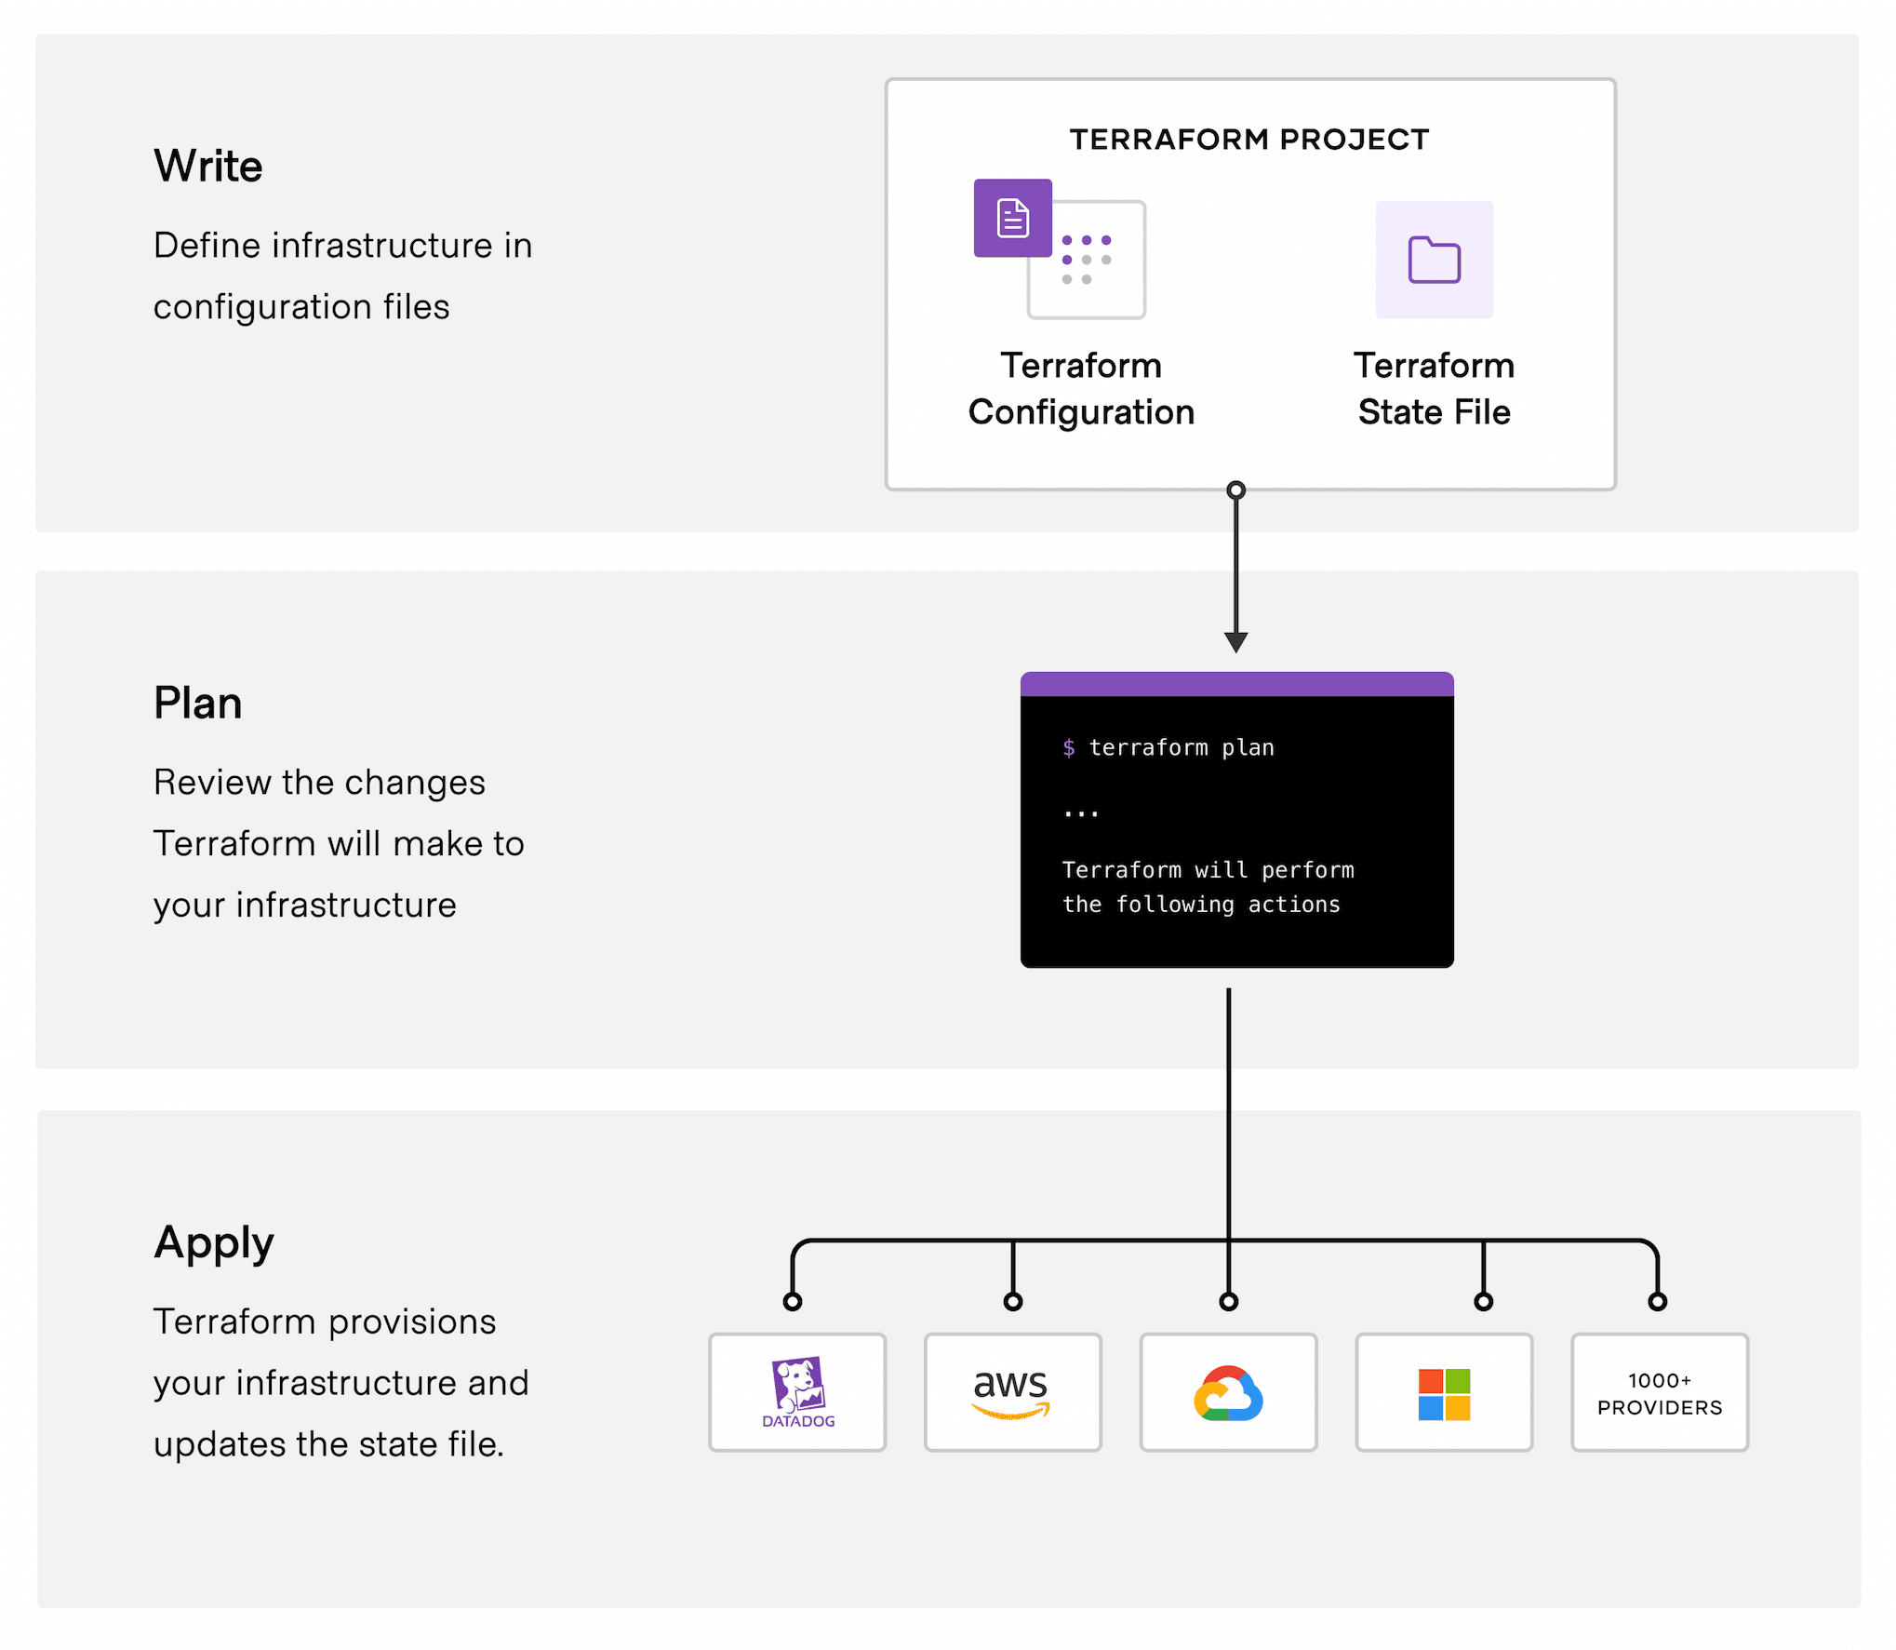
Terraform
Use Cases for Terraform
Multi-cloud infrastructure deployment.
Large-scale deployments.
Benefits of Terraform
State management, clear preview of changes.
Flexibility for different cloud providers.

Slide 25
CaC & PaC
Configuration as Code (CaC)
Managing configurations through source code.
Benefits
Version control, reusability, and automation.
Enables collaboration and auditing.
Policy as Code (PaC)
Defining policies using code for compliance and security.
Benefits
Enforces standards, improves governance.
Implementation in Azure
Use of Azure Policy for managing compliance and security rules.

Slide 26
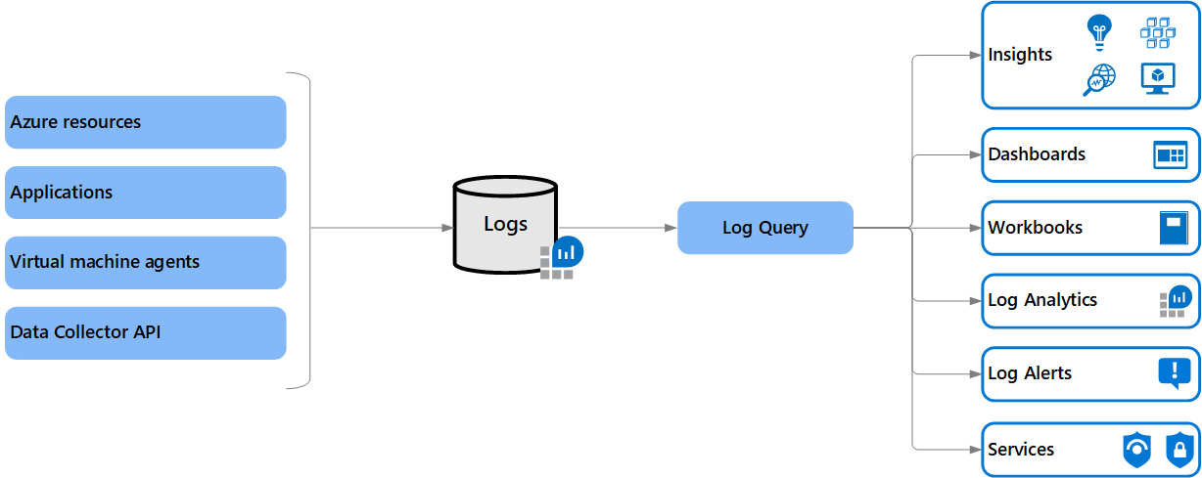
Introduction to Azure Monitoring Tools
Importance of monitoring tools in facilitating IT operations.
Benefits: Reduced costs, improved performance, reliability, and security of cloud infrastructure.

Slide 27
Azure Monitoring Service
Azure Monitor:
Overview:
Centralized tool for monitoring Azure applications and resources.
Provides real-time visibility into health and performance.
Key Features:
Tracks application and service availability.
Configurable alerts via various methods.
Integrates with event-driven services for proactive issue resolution.
Application Insights
Subcomponent of Azure Monitor focused on application metrics and telemetry.
Capabilities:
Observes infrastructure impacting application performance.
Identifies user-related issues and provides insights.

Slide 28
Azure Monitoring Service
Azure Log Analytics
Gathers performance data from applications and infrastructure.
Use Cases:
Identifies and troubleshoots issues impacting cloud resources.
Aggregates logs for comprehensive analysis.
Azure Network Watcher
Monitors networking infrastructure for cloud workloads.
Benefits:
Diagnoses and visualizes networking architecture.
Identifies issues and security risks in network configurations.
Azure Advisor
AI-powered service providing customized suggestions.
Key Features:
Offers performance improvements, cost reductions, and security enhancements.
Acts as an assistant for optimizing Azure resources.

Slide 29
CHAPTER 12 Cloud Management and Governance in Azure
|LEARNING MICROSOFT AZURE

Slide 30
Key Reasons for Cloud Management and Governance
Effective Management of Cloud Resources
Compliance with Regulatory Standards
Consistent Organizational Policies
Optimized Cloud Cost Management
Enhanced Security and Risk Management
Disaster Recovery Management

Slide 31
Azure Resource Locks
Azure resource locks protect cloud assets from accidental deletion or modification.
There are two main lock types:
ReadOnly: Prevents all users from modifying or deleting resources while allowing read access.
CannotDelete: Allows authorized users to read and modify resources but prohibits deletion.
Resource locks follow a parent-child hierarchy, meaning if a lock is applied at the resource group level, all contained resources inherit the same lock.

Slide 32
Azure Blueprints
Azure Blueprints provide predefined templates that help organizations deploy compliant cloud environments efficiently.
Features:
Standardization of Cloud Resources: Automate the deployment of standardized resources adhering to organizational standards and compliance requirements.
Integration with CI/CD Pipelines: Manage blueprints as code for integration with Azure DevOps, facilitating version control and collaboration.
Artifact Management: Each blueprint consists of artifacts like Azure RBAC roles, policies, and resource groups, enabling the creation of compliant cloud infrastructures.

Slide 33
Azure Monitor for Monitoring and Reliability
Overview:
Azure Monitor is a comprehensive cloud-based monitoring service provided by Microsoft Azure
It enables organizations to track the performance and health of their applications and infrastructure.
It offers insights into application health, allowing proactive identification and resolution of issues.

Slide 34
Azure Automation
Overview:
Azure Automation is a cloud-based service that automates repetitive and time-consuming tasks related to Azure resource management.
It aims to streamline workflows and reduce manual effort.
Use Cases:
Provisioning and Managing Virtual Machines: Automate the creation, management, and scaling of VMs.
Managing Backups and Disaster Recovery: Streamline backup processes and disaster recovery planning.
Monitoring System Health: Automate responses to health alerts and maintain system uptime.
DevOps Automation: Integrate with Azure DevOps to enhance release pipelines and automate testing.

